Slide 1
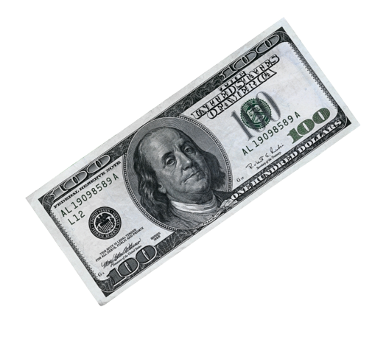
The ingenious concept without investment risk
with the world's best marketing plan

Slide 2
The story behind the story
year 2016

Slide 3
The story behind the story
All parties involved established three basic rules to ensure that the project would not be jeopardized at any time:
All involved founders, banks, insurance companies and users remain absolutely anonymous, because one was sure that this project will also find enemies and is thus a completely private community without company headquarters, CEO, etc..
Wallet holders cannot withdraw the capital provided by the bank and the staking profits during the entire term. After the term, the bank capital is immediately returned and the remaining proceeds are settled with the wallet holder.
All monthly insurance premiums and annual bank interest are settled solely by staking profits and are not dependent on the wallet holder.
No sooner said than done - Cryptex was born!

Slide 4
Who or what is Cryptex?
Community
Founders
Leaders/Superleaders
Programmers
Banks
Supporters
Users/Wallet holders
Insurances

Slide 5
The WIN - WIN - WIN situation
The insurance
insures the wallet for total loss and credit default. These policies have been developed and adapted by the partner insurers specifically for these projects. They receive uninterrupted, secure monthly premiums (depending on the contract) from the staking profits, during the agreed term.
The bank
on the basis of this insurance coverage, the partner banks provide capital. They receive from the staking profits without interruption, secure annual interest for the agreed term. In addition, collateral and reserves have been built up over the years, which are also available to the bank.
The wallet owner
The respective contract is settled after the agreed term. The capital is paid back to the bank and the remaining profits are booked onto the holder's wallet. The wallet balance can then be paid out immediately using the available method - currently Bitcoin.

Slide 6
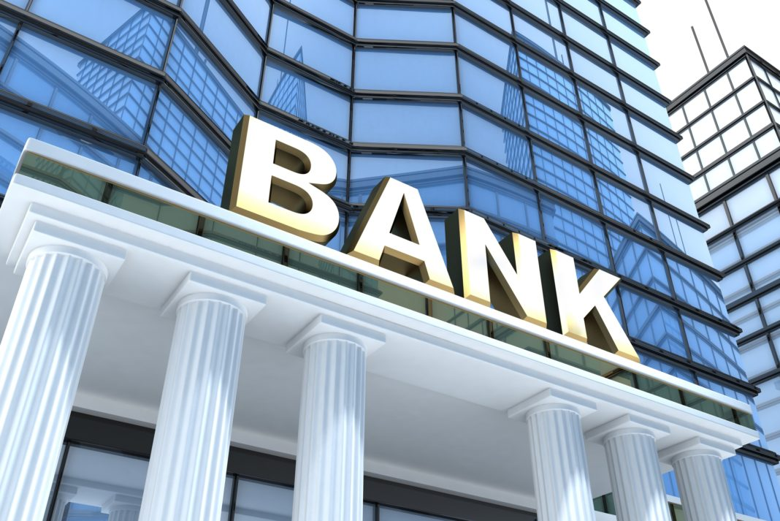
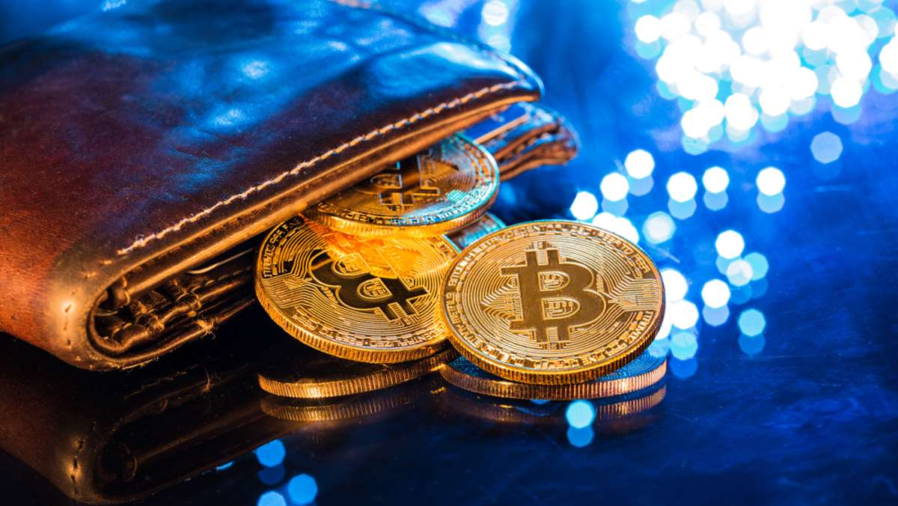
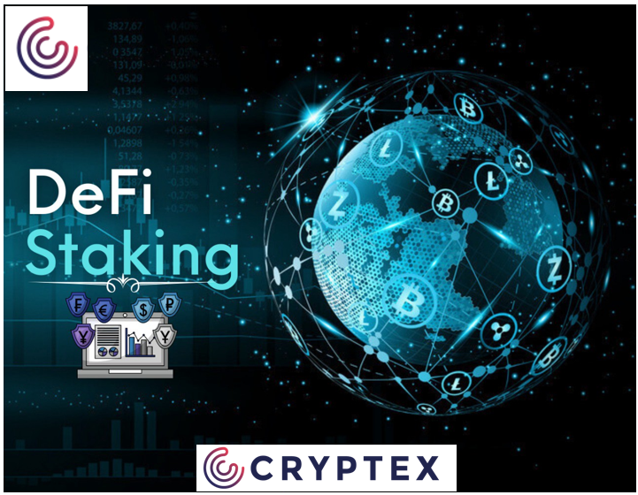
The installments for the insurance and the interest for the loan are paid from the staking profits
The WIN - WIN - WIN situation
PROTECTION
CONTRACT
CAPITAL
RETURN
100 USD fee
per contract
*Maximum
20 contracts
Customer Wallet
STAKING
PROFIT
CONTRACT
Uncertainty factor
of the “human"
is excluded!
DeFi HYBRID CONTRACT
*plus special offers

Slide 7
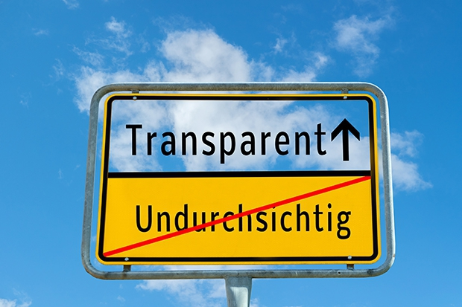
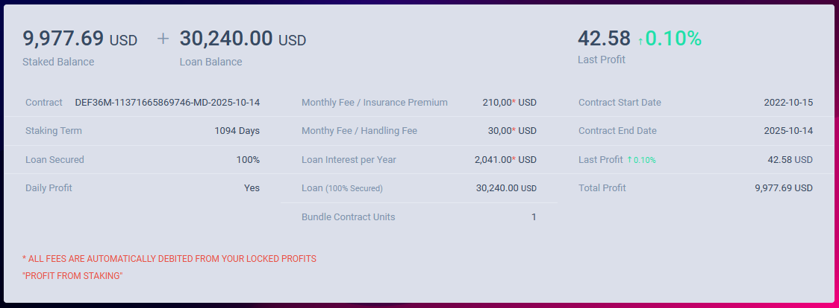
The DeFi-Hybrid Contract
3-Year Duration
Status: 09/23

Slide 8
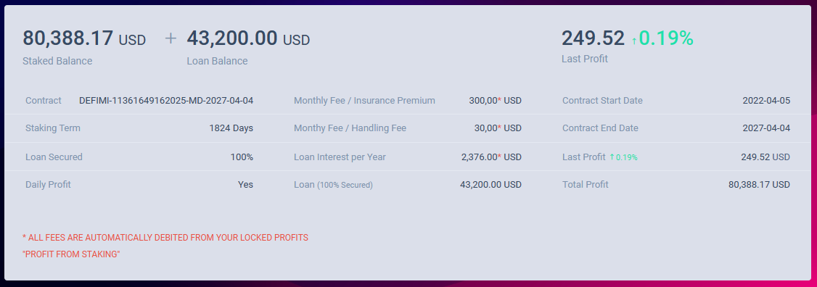
The DeFi-Hybrid Contract
5-Year Duration
Status: 09/23

Slide 9
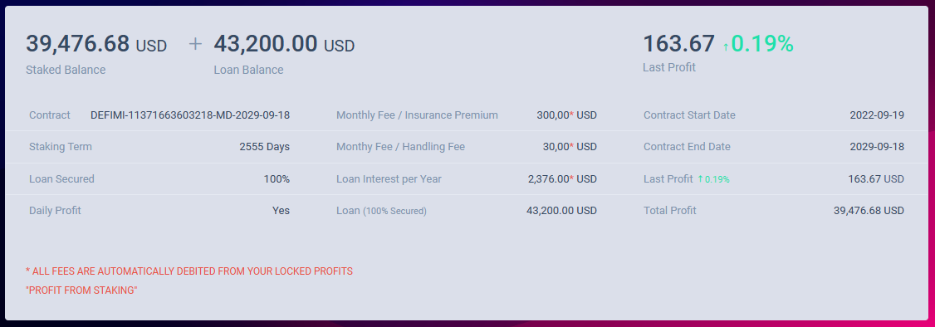
The DeFi-Hybrid Contract
7-Year Duration
Status: 09/23

Slide 10
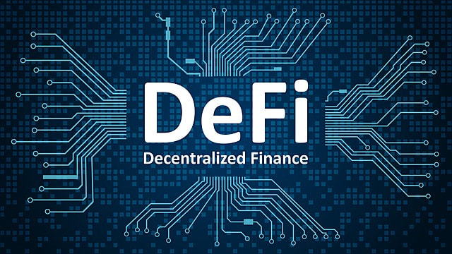
What is DeFi-Staking?
Decentralized Finance Staking
Those who engage in staking thus support a blockchain network in complying with the consensus mechanism (In blockchain systems, the consensus mechanism defines the way in which blocks are generated and inserted into the blockchain) As a reward for this protection of the network, one receives "staking rewards", i.e. returns on the stake. Especially for investors with a longer-term horizon, this is a good way to generate passive income.
DeFi-Staking is the modern savings book - but much more lucrative, because daily compensation/rewards of 0.01% to 0.3% are quite possible with Staking.

Slide 11
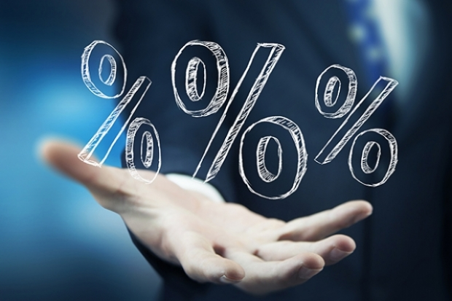
Future prospects
DeFi Hybrid 36
DeFi Hybrid 36 Pack
DeFi Hybrid 60
DeFi Hybrid 84
0,05% to 0,15%
daily profit
0,05% to 0,15%
daily profit
3 years
3 years
5 years
0,10% to 0,30%
daily profit
0,10% to 0,30%
daily profit
7 years
approx. 35,000 USD*
approx. 500,000 USD*
approx. 300,000 USD*
5 comlimentary contracts
approx. 1,000,000 USD*
*Past results are no guarantee of future success.

Slide 12
Millionaire Plan
DeFi Hybrid 36 Pack
DeFi Hybrid 60
DeFi Hybrid 84
3 years
2x
DeFi 36 Pack
10x
DeFi 60
5 years
10x
84 Pack
7 years
approx. 1,000,000 USD*
4.000 USD
Fee
approx. 3,000,000 USD*
approx. 10,000,000 USD*
*Past results are no guarantee of future success.

Slide 13
100 USD – Savings plan
On the basis of DeFi-Hybrid 36
1. month 1 DeFi 36 100 USD
In the 36th month 35.000 USD
2. month 1 DeFi 36 100 USD
In the 37th month 35.000 USD
3. month 1 DeFi 36 100 USD
In the 38th month 35.000 USD
4. month 1 DeFi 36 100 USD
In the 39th month 35.000 USD
5. month 1 DeFi 36 100 USD
In the 40th month 35.000 USD
37th month 1 DeFi 36 100 USD
etc.
In the 73rd month 35.000 USD
etc.
3.700 USD- total fee
In the 73rd month already 1.260.000 USD received!!!
*Past results are no guarantee of future success.

Slide 14
100 USD – Savings plan with 300 USD Extra payment
On the basis of DeFi-Hybrid 36
1. month 3 DeFi 36 300 USD
In the 36th month 105.000 USD
2. month 1 DeFi 36 100 USD
In the 37th month 35.000 USD
3. month 1 DeFi 36 100 USD
In the 38th month 35.000 USD
4. month 1 DeFi 36 100 USD
In the 39th month 35.000 USD
5. month 1 DeFi 36 100 USD
In the 40th month 35.000 USD
37th month 1 DeFi 36 100 USD
etc.
In the 73rd month 35.000 USD
etc.
3.900 USD- total fee
In the 73rd month already 1.365.000 USD received!!!
*Past results are no guarantee of future success.

Slide 15
100 USD – Savings plan with 1000USD Extra payment
On the basis of DeFi-Hybrid 36
Start with the DeFi 36 Pack 1.000 USD
In the 36th month 500.000 USD
2. month 1 DeFi 36 100 USD
In the 37th month 35.000 USD
3. month 1 DeFi 36 100 USD
In the 38th month 35.000 USD
4. month 1 DeFi 36 100 USD
In the 39th month 35.000 USD
5. month 1 DeFi 36 100 USD
In the 40th month 35.000 USD
37. month 1 DeFi 36 100 USD
etc.
In the 73rd month 35.000 USD
etc.
4.600 USD – total fee
In the 73rd month already 1.760.000 USD received!!!
*Past results are no guarantee of future success.

Slide 16
Friendship Bonus

Slide 17
Friendship Bonus
You have three income options:
Direct commission (Rewards Referral Program) available within a minute!
Daily profit sharing (Rewards Referral Staking) on your referrals at the end of the contract period.
Leader Commission - Rewards Leader Program

Slide 18
Friendship Bonus
Commissions from profit sharing*
Instant commissions
3 year contracts
Leader Program
all contracts
1 Level 8%
2 Level 5%
3 Level 5%
4 Level 5%
5 Level 4%
6 Level 4%
7 Level 4%
8 Level 4%
9 Level 3%
10 Level 3%
11 Level 3%
12 Level 3%
13 Level 2%
14 Level 2%
15 Level 2%
16 Level 2%
17 Level 1%
18 Level 1%
19 Level 1%
20 Level 1%
1 level = 30%
2 Level = 5%
3 Level = 5%
4 Level = 5%
5 Level = 4%
6 Level = 4%
7 Level = 3%
8 Level = 3%
9 Level = 3%
10 Level = 3%
Direct commissions
from level 1
5%
*payable after end of contract

Slide 19
Friendship Bonus
Instant commission
3 year contract
Pack of 10
(10 pay/15 get)
Gratis
current
5 and 7 year contracts
+
+
+
User has deposited 4000 USD
and has 2 x 10 pack 3 year, 10 x 5 and 10 x 7 year contracts,
so a total of 50 contracts acquired per wallet

Slide 20
Friendship Bonus
Instant commission
30%
FIRSTLINE Bonus
+
+
+
4000 USD x 30% = 1200 USD
Instant commission

Slide 21
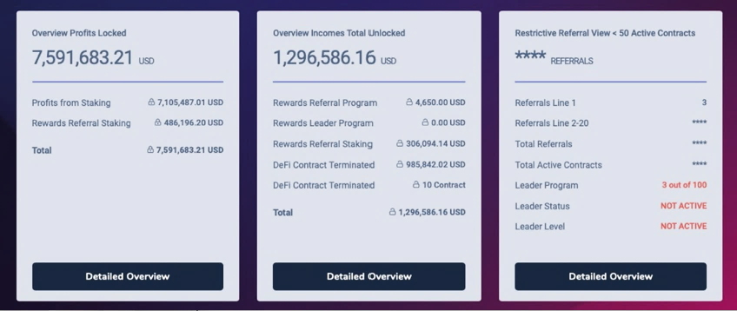
Friendship Bonus
Commissions from profit sharing
payable after end of contract
1 Level 8%
2 Level 5%
3 Level 5%
4 Level 5%
5 Level 4%
6 Level 4%
7 Level 4%
8 Level 4%
9 Level 3%
10 Level 3%
11 Level 3%
12 Level 3%
13 Level 2%
14 Level 2%
15 Level 2%
16 Level 2%
17 Level 1%
18 Level 1%
19 Level 1%
20 Level 1%
Status: 03/23

Slide 22
Friendship Bonus
Commissions from profit sharing
payable after end of contract
Example:
1 x Defi-Hybrid 36
(without compound interest)
Profit on current course
approx. 35000 USD
Profit sharing
Direct so 1 level = 2800 USD
2 Level = 1750 USD
3 Level = 1750 USD
4 Level = 1750 USD
5 Level = 1400 USD
6 Level = 1400 USD
20 Level = 350 USD
1 Level 8%
2 Level 5%
3 Level 5%
4 Level 5%
5 Level 4%
6 Level 4%
7 Level 4%
8 Level 4%
9 Level 3%
10 Level 3%
11 Level 3%
12 Level 3%
13 Level 2%
14 Level 2%
15 Level 2%
16 Level 2%
17 Level 1%
18 Level 1%
19 Level 1%
20 Level 1%

Slide 23
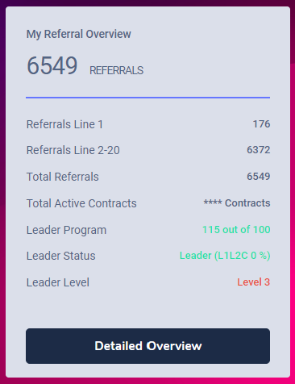
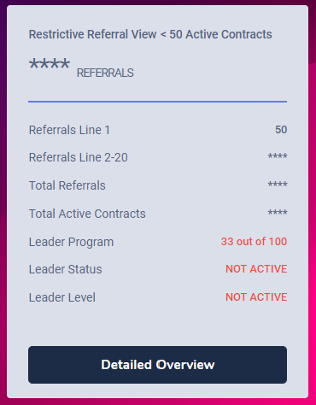
Friendship Bonus
LEADER PROGRAM
Starts with the
first
Recommendation
Direct commissions
from level 1
5%
Monthly
qualification
Basis to the leader are 100 directly recruited with minimum 1 contract.
The first commission settlement of 5% retroactive to the first recruited user takes place at 100.000,00 USD fee turnover in the complete downline, after that monthly settlement!
Monthly qualification: 100 contracts/month/1/2 level equals 100% participation (e.g. 30 K. = 30% share)

Slide 24
Scam-Check

Slide 25
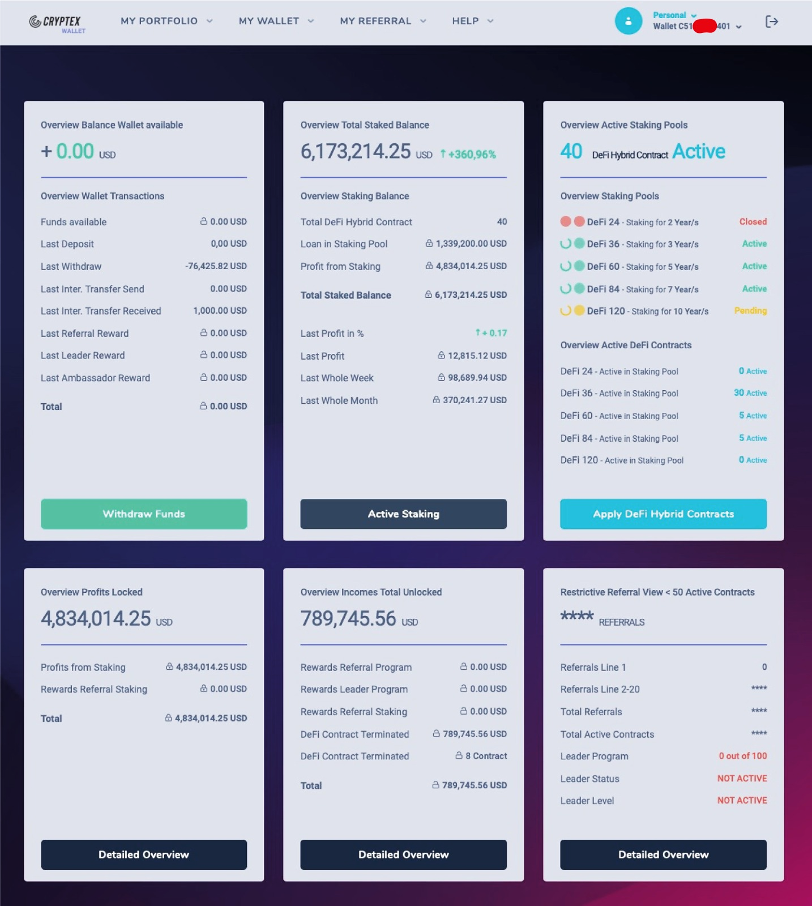
since 2017 with us
with only
4800 USD fees
Status: 03/23

Slide 26
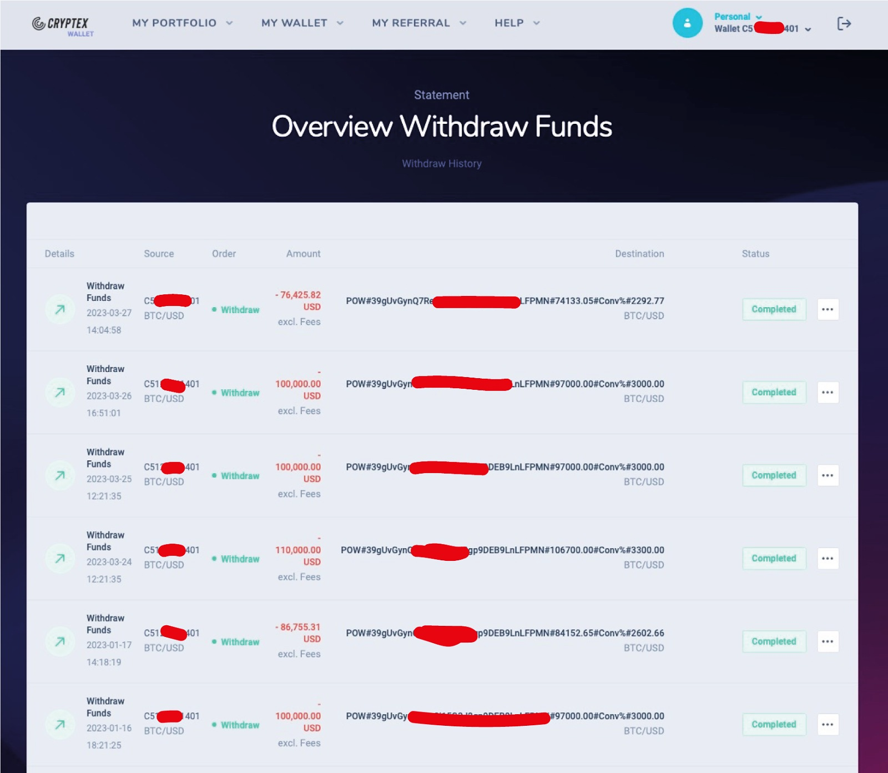
Status: 03/23

Slide 27
Revenue/Expenditure
100 USD per contract!
Of these are already only in our line,
so demonstrable!:
65 USD for the 3/10 level marketing plan
50 USD for 10 x 5 USD (indefinitely) for Leader
1 x 35 USD (indefinitely) for Superleader L6
1 x 15 USD (indefinitely) for Superleader L3
165 USD IMMEDIATE COMMISSION
100 USD in
165 USD out immediately
FRAUD???
Status: 07/23

Slide 28
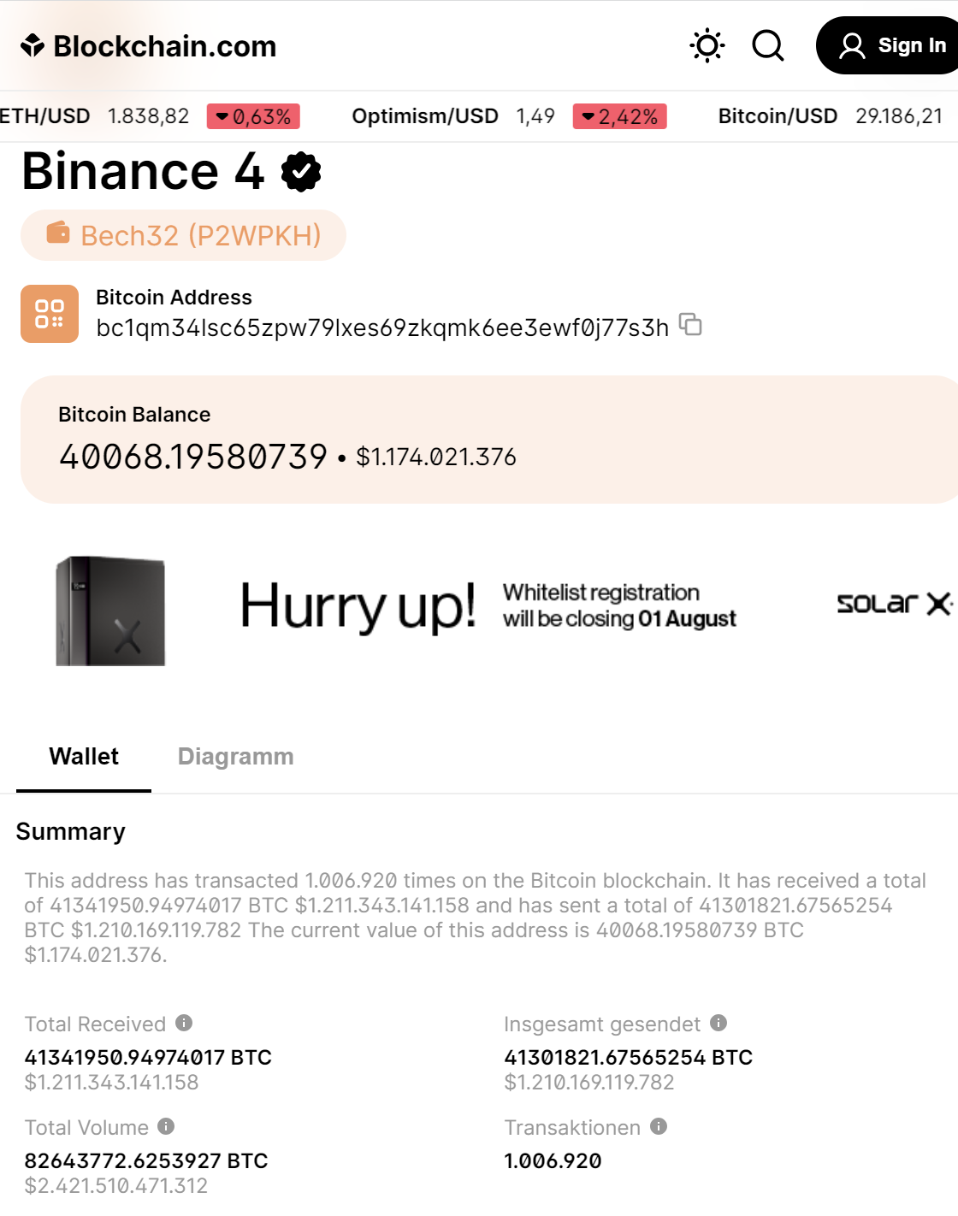
The blockchain lies
NOT!
Account movement
over 2.4 billion
USD
Status: 25/07/23

Slide 29
Summary
No investment risk - only 100 USD fee per contract
Manageable terms of 3, 5, 7 to 10* years
Complete anonymity of all participants
Scam/fraud excluded (100 in/165 out)
All contracts due to date are proven to have been paid out
6. Top direct commission, plus profit sharing and all commissions due to date have been proven to have been paid out
7. Blockchain proofs of capital
*by the end of the year 2023

Slide 30
Good prospects

Slide 31
Now please contact the person who enabled you to attend this webinar!
This webinar was a recent recording and will be renewed periodically as needed.

